Slide 1


web designing Travel and tourism
Mohammed Meharab (23BTRE125)
Maha Jai Ganesh (23BTRE122)
Sadiya Banu (23BTRE137)
Taqia Aiman(23BTRE147)

Slide 2

Introduction
Creating a basic travel and tourism website using HTML and CSS involves structuring the content and styling it to attract and inform visitors about destinations, services, and more.

Slide 3
web development tools
Frontend Development:
HTML/CSS: Structure your website using HTML for content and CSS for styling.
JavaScript: Enhance interactivity and functionality.
*Backend Development (Optional, for dynamic content):
Node.js: Server-side JavaScript environment.
Express.js: Framework for building web applications with Node.js.
3. Key Features for the Website:
Homepage: Welcome users with an attractive layout showcasing popular destinations or travel packages.
Destination Pages: Detailed information about various places to visit, activities, accommodations, etc.
Booking System: If applicable, allow users to book flights, hotels, tours, etc.

Slide 4
Brief introduction to the concept of tourism websites
1. Centralized Information Hub: Tourism websites compile all the necessary travel information in one place
2. Easy Booking and Reservations: These websites offer integrated booking systems that allow users to reserve flights, hotels, tours, and rental cars directly from the site
User Reviews and Ratings: User-generated content, such as reviews and ratings, plays a crucial role in tourism websites.
Virtual Tours and Maps: To help travelers explore destinations before they visit, many tourism websites feature virtual tours and interactive maps.
Tourism websites have revolutionized the way people plan and experience travel. By offering a comprehensive, user-friendly platform for information, booking, and personalized recommendations, these websites make travel more accessible, efficient, and enjoyable

Slide 5
Why go trip??
Key Features of Our Tourism website
Interactive Virtual Tours: Embedded Google Maps for real-time navigation
Easy Booking System: Simple an
User Reviews and Ratings: Feedback and testimonials from other travelersd efficient booking process
Share experience through a partner app- explugerger

Slide 6
HTML Tags Used
<header class="head">
<a href="#" class="log">Go Trip</a>
<nav class="navbar">
<a href="#Home" class="active">Home</a>
<a href="#Services">Tours</a>
<a href="#skills">Package</a>
<a href="#virtual-tours">Virtual Tours</a>
<a href="#contact">Contact Us</a>
</nav>
<a class="btn" href="#">BOOK NOW</a>
</header>
<header>: Defines a header for a document or section
<nav>: Defines navigation links
<section>: Defines a section in a document
<div>: Defines a division or section in an HTML document
<iframe>: Embeds an external resource (Google Maps)

Slide 7
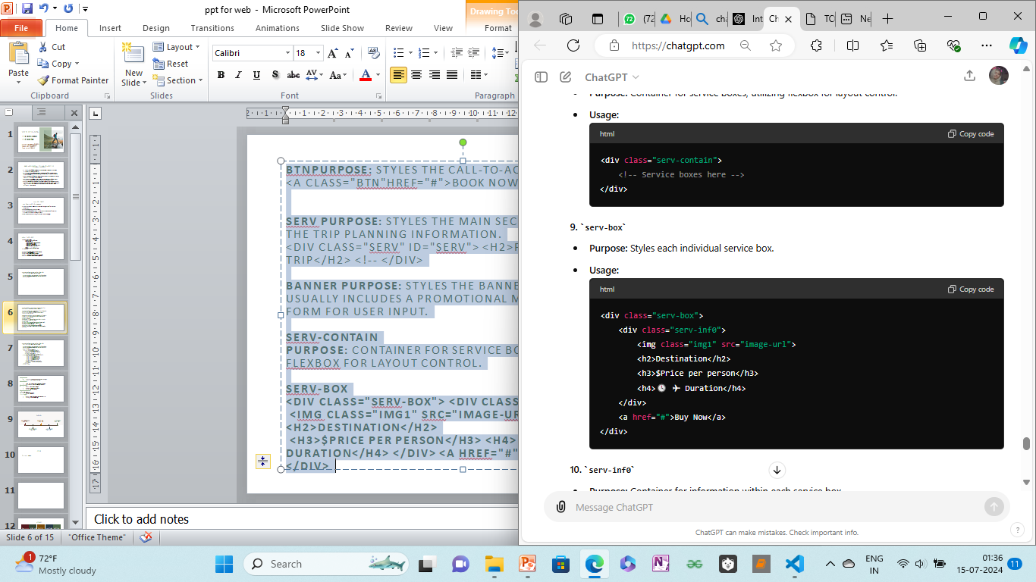
btnpurpose: styles the call-to-action button. <a class="btn"href="#">book now</a> →serv purpose: styles the main section containing the trip planning information. <div class="serv" id="serv"> <h2>plan your trip</h2> <!-- </div> →banner purpose: styles the banner section, which usually includes a promotional message and a form for user input. →serv-contain purpose: container for service boxes, utilizing flexbox for layout control. →serv-box <div class="serv-box"> <div class="serv-inf0"> <img class="img1" src="image-url"> <h2>destination</h2> <h3>$price per person</h3> <h4>🕓 ✈ duration</h4> </div> <a href="#">buy now</a> </div>

Slide 8
Important CSS Functions
Flexbox: Used for layout control
.serv-contain {
display: flex;
justify-content: space-around;
flex-wrap: wrap;}
Responsive Design: Ensuring the app works on all devices.
@media (max-width: 768px) {
.serv-box {
width: 100%;}}
Styling Buttons: Consistent button design across the app
.btn {
background-color: #ff9900;
color: #fff;
padding: 10px 20px;
border-radius: 5px;}

Slide 9
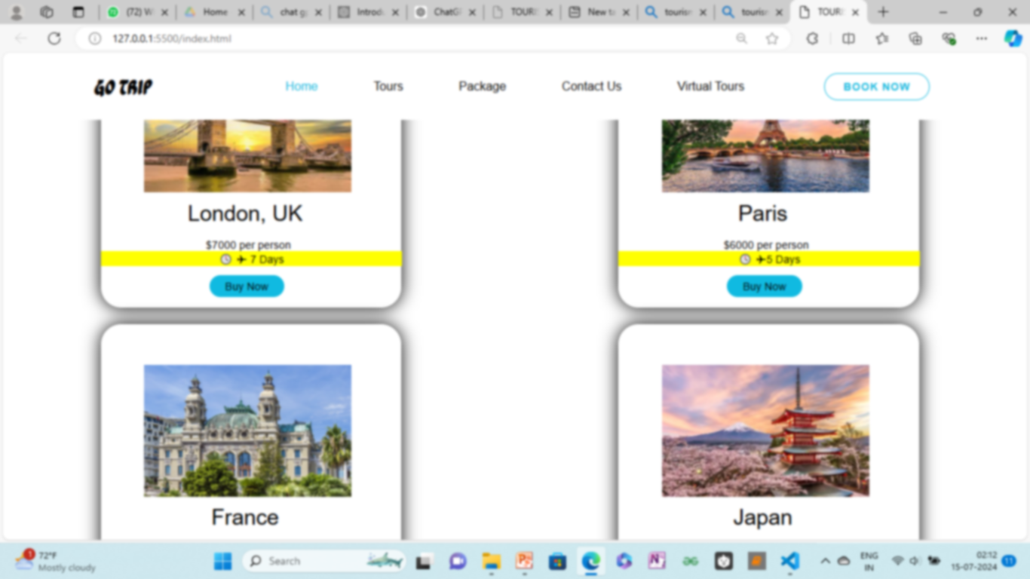
code
Tourism website – go trip
C:\Users\Admin\Desktop\go trip\index.html
C:\Users\Admin\Desktop\go trip\tour.css

Slide 10
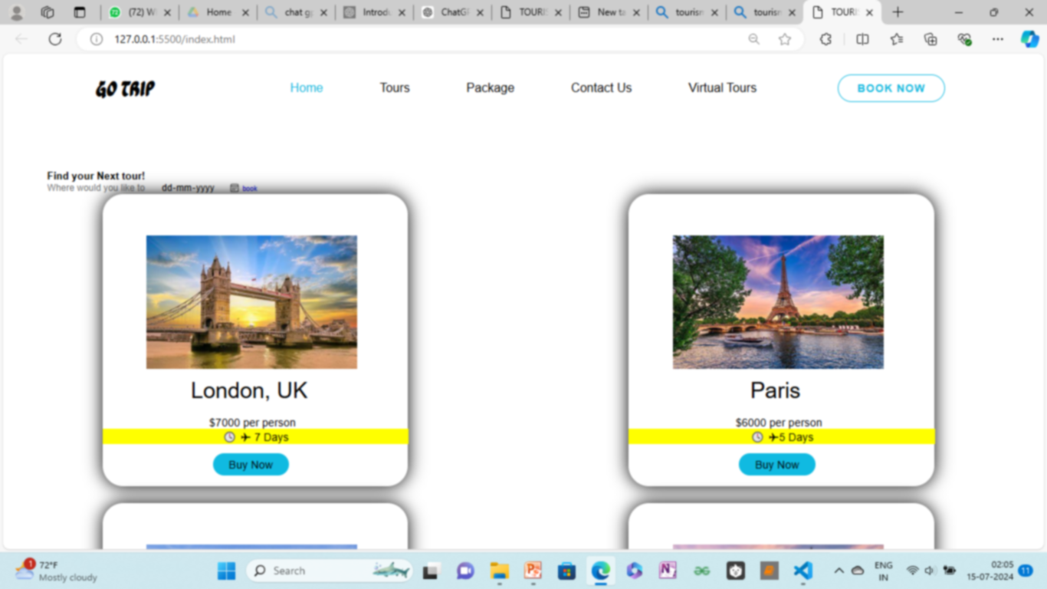
How Our website Enhances Customer Experience
Simplifies the planning process
Provides real-time information
Personalized recommendations based
on user preferences.
Access to user reviews and ratings

Slide 11
Summary
→Areas for Improvement:
Responsiveness: Ensure the website is fully responsive across all devices to cater to mobile users effectively.
Performance Optimization: Address load time issues by optimizing images, minifying code, and leveraging caching strategies.
Security Measures: Implement HTTPS and validate user inputs to bolster security and protect user data.
→Future enhacement
SEO Optimization:
Improve search engine optimization (SEO) by optimizing meta tags, using structured data, and enhancing content to attract more organic traffic.
Complexity and Maintenance
Issue: Complex codebases can lead to difficult maintenance, bugs, and slower development cycles.

Slide 12
Thank you !

